Slide 1
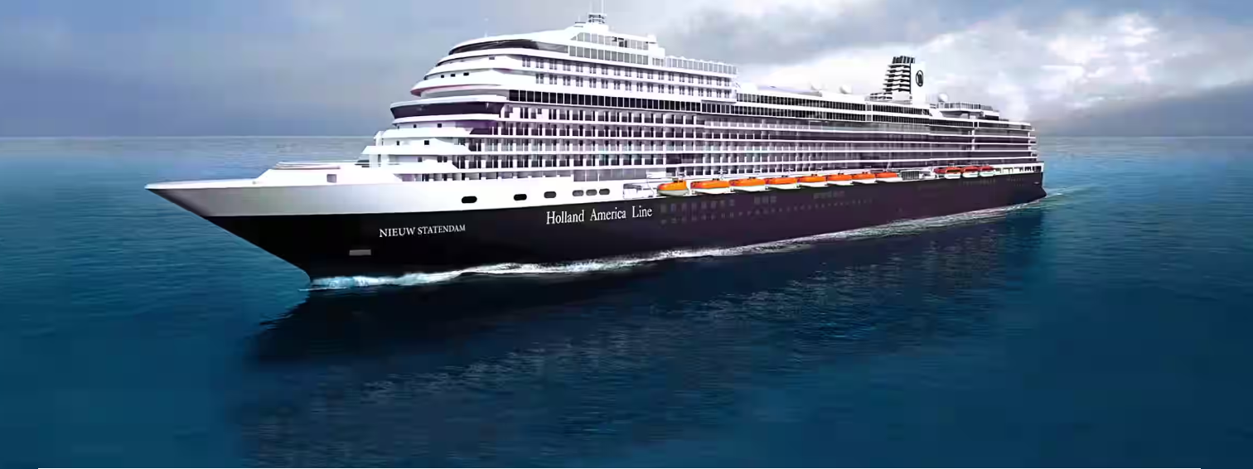
Holland America Line Case Study
Zhen Xu
04/04/2023

Slide 2
Overview
Goal of the Case Study
Given a cruise line (subtrade) to be marketed, what kind of guests should HAL contact at what time with what content?
When to target
Who to Target
What to target
What are the most popular booking month for each subtrade?
With a given subtrade, what guest segmentation should we target?
What message should we deliver to the targeted audience?
Other Considerations
Identifying customer personas with clustering model
Looking forward…

Slide 3
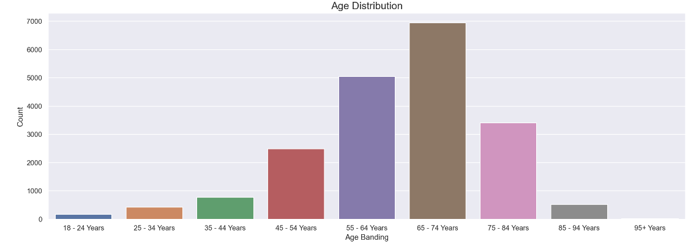
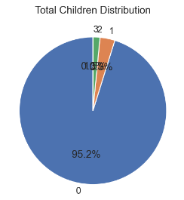
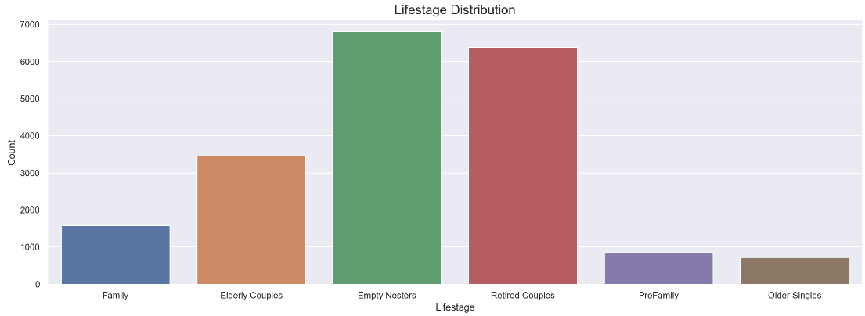
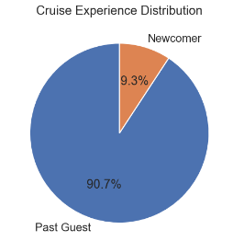
Data Cleaning
Simple Exploratory Data Analysis
Overall Distribution of Multiple Variables
1. Checking data type
2. Checking data range of numerical variables
3. Checking the consistencies of categorical variables
4. Cleaning Texts
5. Checking missing values
6. Checking duplicate values

Slide 4
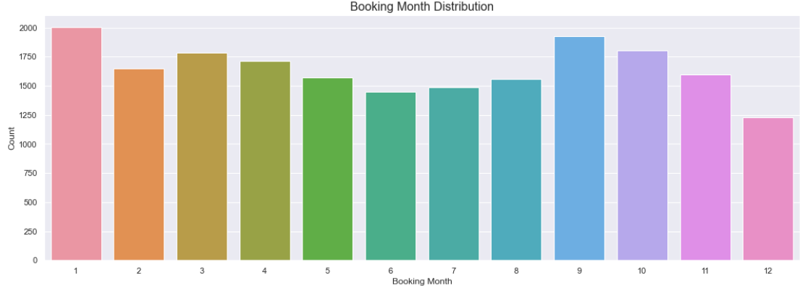
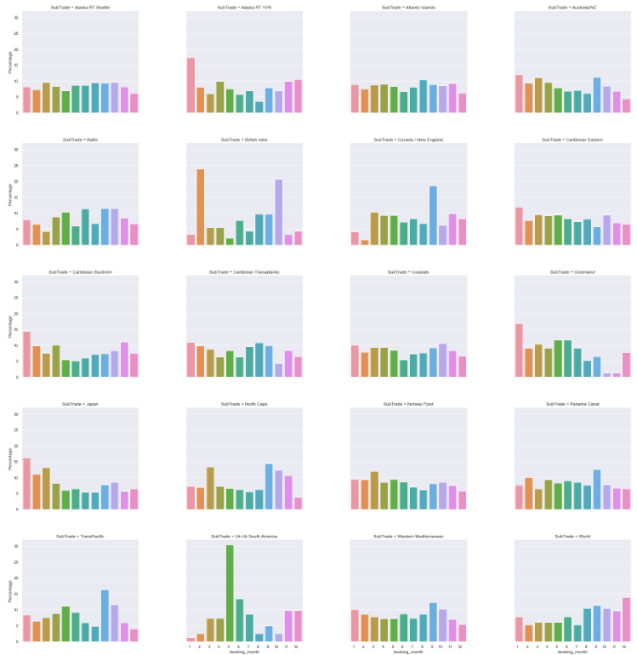
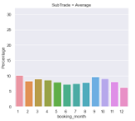
When to Target
Q: Given a particular subtrade, when should we reach out to guests?
Distribution of Monthly Booking for Each Subtrade
Average
Insights from the upper chart:
Months such as January and September have higher volume of booking while months such as December have low booking volume.
Possible Reasons
Strategy:
Offer discounts in off-season months to increase booking
Send more personalized communications during peak months to increase marketing efficiency
Insights from the right chart:
We could derive insights on: For each subtrade, which month(s) witness higher likelihood of booking compared to average.
Strategy:
To do marketing for a specific subtrade, send marketing communications during/before high-booking months.

Slide 5
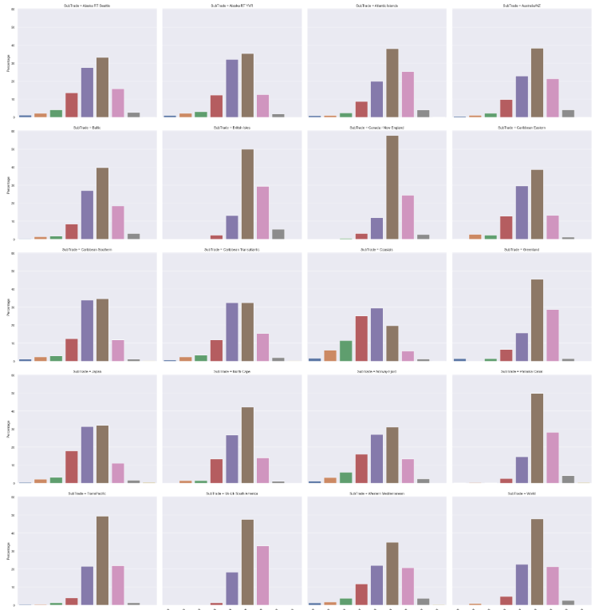
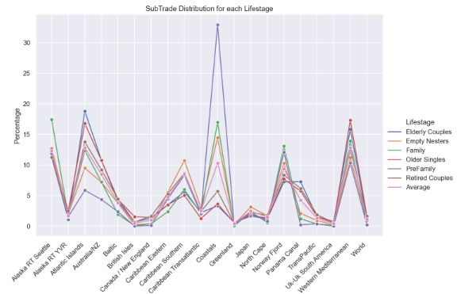
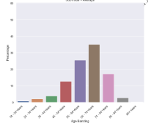
Who to Target & What to Target
Q: Given a particular subtrade, what kind of guests will be most interested?
Distribution of Age for Each Subtrade
Subtrade
Insights from right chart
We can identify the best age segment to target given a specific subtrade.
For example, Canada/ New England has a population heavily skewed towards the elderly.
Strategy
Insights from the upper chart:
We can also break down life stage by subtrade.
This chart shows for each life stage, what subtrades interest them most.
Families like subtrade “Alaska RT Seattle”; Pre-families like subtrade “Coastal” etc.
Strategy: Target guests who are in life stages that show preference for a particular subtrade.
Average

Slide 6
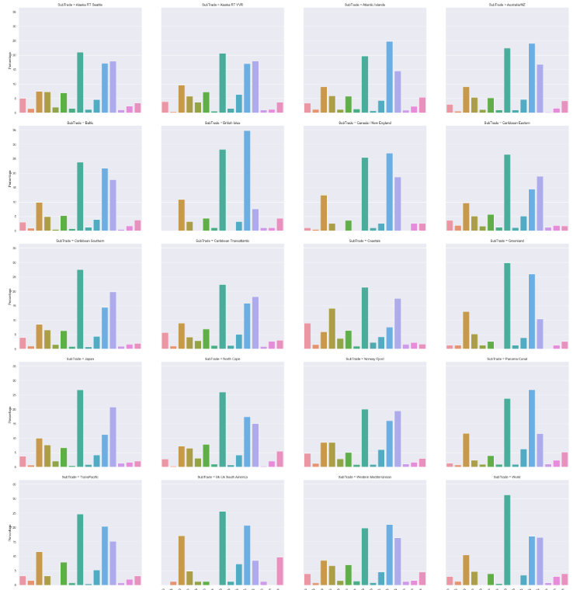
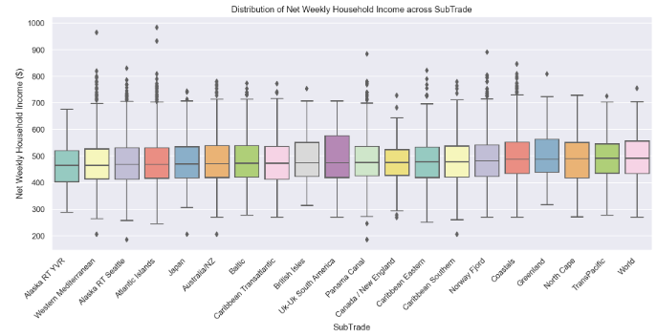
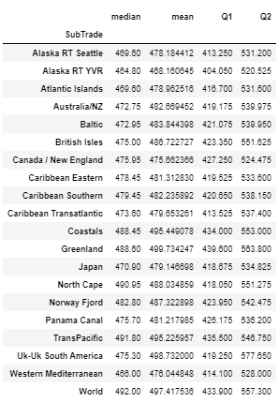
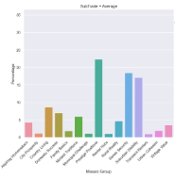
Who to Target & What to Target
Q: Given a particular subtrade, what kind of guests will be most interested?
Distribution of Mosaic Group for Each Subtrade
Subtrade
Insights:
Strategy:
Identify the best mosaic groups to target given a specific subtrade.
Insights from the upper/left charts:
The weekly HH income distribution across subtrades does not differ much.
Alaska RT YVR has the lowest median income while Greenland has the highest.
Average

Slide 7
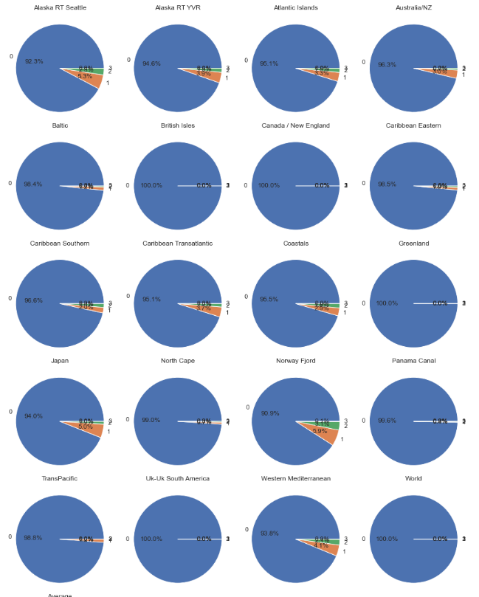
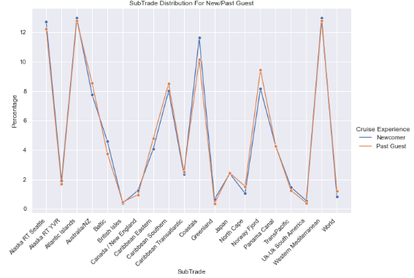
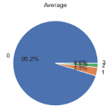
Who to Target & What to Target
Q: Given a particular subtrade, what kind of guests will be most interested?
Distribution of Children Number for Each Subtrade
Subtrade
Insights from the right chart:
The population on subtrades such as "British Isles", "Canada / New England", "Greenland" have fewer children than average (almost all adults). The population on other subtrades such as "Japan", "Alaska RT Seattle", "Norway Fjord" have more children than average. In particular, "Norway Fjord" is the subtrade with the highest three children proportion.
Strategy:
Given a subtrade and its appealing to families with children, we can send customized emails/mails based on a family’s children number
Insights from the left chart:
The choice of subtrades does not differ much for new/old guests.
There are some minor differences in “Coastal” and “Norway Fjord”.
Average

Slide 8
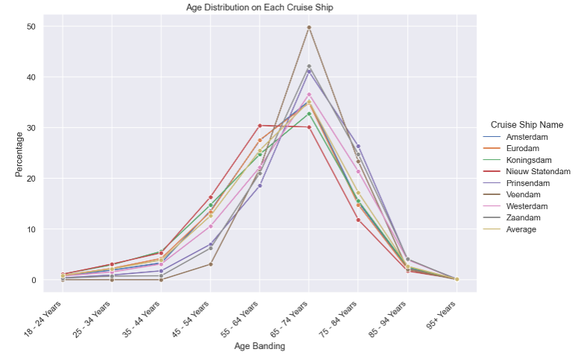
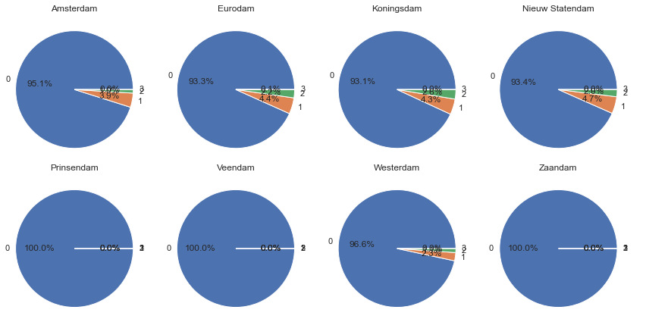
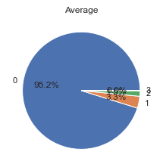
Who to Target & What to Target
Q: Given a particular cruise ship, what kind of guests will be most interested?
Cruise Ship Name
Distribution of Age for Each Cruise Ship
Distribution of Children Number for Each Cruise Ship
Insights:
Compared to average, the population of some ships (e.g. Nieuw Statendam, Eurodam, Koningsdam) are skewed towards the younger population while others (e.g. Veendam, Zaandam, Prinsendam) are skewed towards the older.
Strategy: Contact guests based on a ship’s attractiveness to younger/older population
Insights:
Some ships, such as "Prinsendam" and "Veendam", have higher adult population, while others, such as "Nieuw Statendam" and "Eurodam", have higher children population compared to average.
Strategy: Send emails/mails based on a ship’s attractiveness to children.
Average

Slide 9
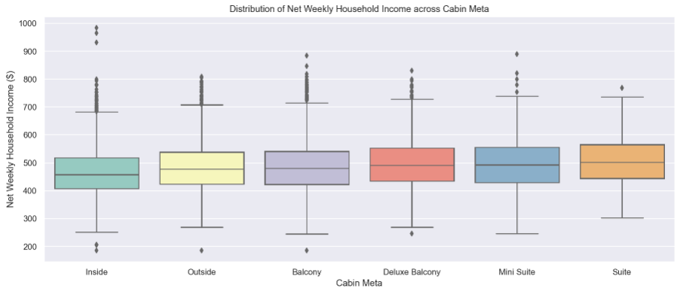
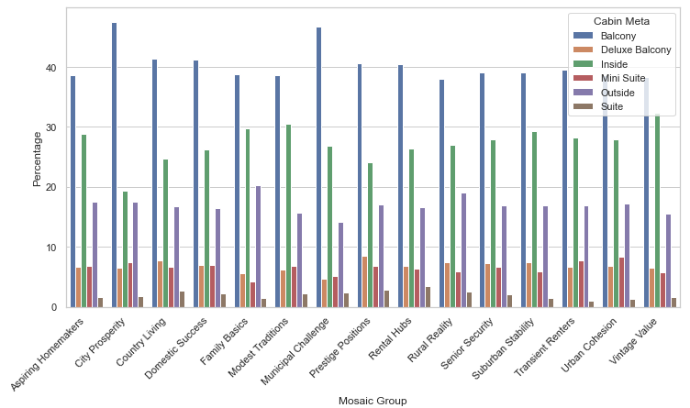
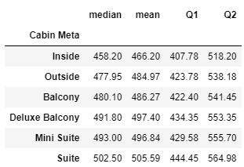
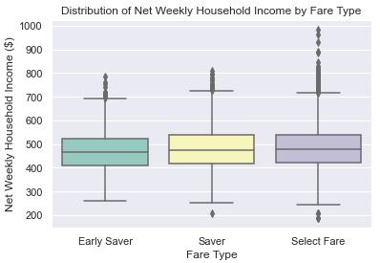
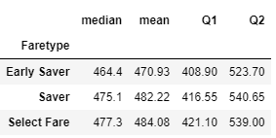
Who to Target & What to Target
Q: Given a particular fare type/cabin meta, what kind of guests will be most interested?
Cabin Meta & Fare Type
Distribution of Income for Each Cabin Meta
Distribution of Cabin Meta for Each Mosaic Group
Cabin Meta
Fare Type
Insights:
Income: For Cabin Meta, the income level of guests gradually increases from “Inside” to “Suite”. The same phenomenon is also seen in Fare Type.
Mosaic Group: Certain mosaic groups (e.g. City Prosperity, Municipal Challenge) have strong preference for certain cabin metas (e.g. Balcony).

Slide 10
Personalized Communication Strategy for “Coastals”
Here is an example!
The peak booking month is October and the most off-season month is June
Strategy: Contact guests in October (or a bit earlier than October) and reduce marketing effort near June.
When to Target
Age Banding: Younger population
Life Stage: Pre-family & Family, focusing more on pre-family
Mosaic Group: Aspiring Homemakers, Domestic Success etc.
Mosaic Type: Alpha Families, Primary Ambitions, avoiding Classic Grandparents etc.
Net Weekly HH Income: Between $434 - $553, with a focus on > 488
Total Children: People both with/without children
Cruise Experience: Both, focusing more on newcomers.
Who to Target
Strategy: In personalized messages, stress how the journey/facilities on the ship are attractive to young people/ families with exquisite taste.
Examples of further segmentation:
- Fare Type: If guest’s income is from $434 - $ 464 -> promote “Early Saver”
- Cabin Meta: If guest’s income is from $434 - $ 458 -> promote “Inside”
What to Target

Slide 11
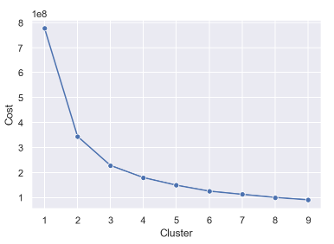
Other Considerations
1. K-Prototype Clustering Model
Identified number of clusters through the elbow method
Help better understand the composition of guest population
2. Other Variables Helpful for Personalization
Cruises Completed with HAL: a measure of loyalty -> Targeting Priority
Cruise Experience:
Newcomer: no information about the new guest -> Recommend the most well-established cruise lines
Past Guest with high number of Cruises Completed with HAL -> Whenever we have new cruises, make them top priorities of marketing effort.
3. Other Means of Contact
Expanding means of contact to include apps, live chat, phone calls, text messages
It is important to balance conversion rate against cost
3. Collect more data
To find the optimal frequency/time of sending mails/emails to increase response rate
After launching the marketing campaigns, collect data on whether the guest responded to the email or not. With sufficient training data, we could build classification models to predict customer response. This will help HAL optimize ways of personalization in the future.

